Slide 1

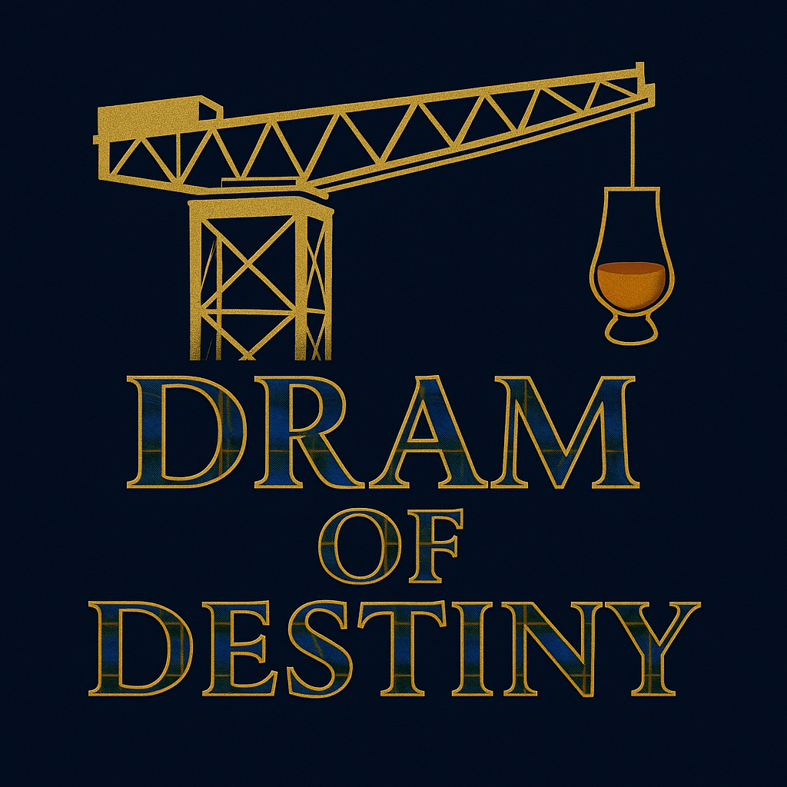

30 January 2027
S.E.C. Glasgow
“Not since Brigadoon has Scotland seen a night like this — where its people, poetry, and spirit come together to make history.”
A Barrel & Brand Project

Slide 2
The Vision
One night,
One stage,
One proud nation!
2,500 people raising a dram in honour of Robert Burns and Scotland’s spirit.
All profits to the My Name’5 Doddie Foundation, fighting Motor Neurone Disease.

Slide 3
The Challenge
We aim to make history by breaking
Two Guinness World Records in a single night:
🥇 Largest Burns Supper (Current: 926, Edinburgh)
🥇 Largest In-Person Whisky Tasting (Current: 2,283, Sweden in 2019)
A celebration worthy of Scotland’s global legacy,
not just in numbers, but in meaning.

Slide 4
Why We’re Doing It
Because Scotland’s story deserves a night that honours both its past and present.
Because whisky isn’t just a drink — it’s craft, culture, and connection.
Because Doddie Weir’s legacy reminds us what courage, kindness, and unity truly mean.
This isn’t just an event. It’s a toast to what makes Scotland remarkable.

Slide 5
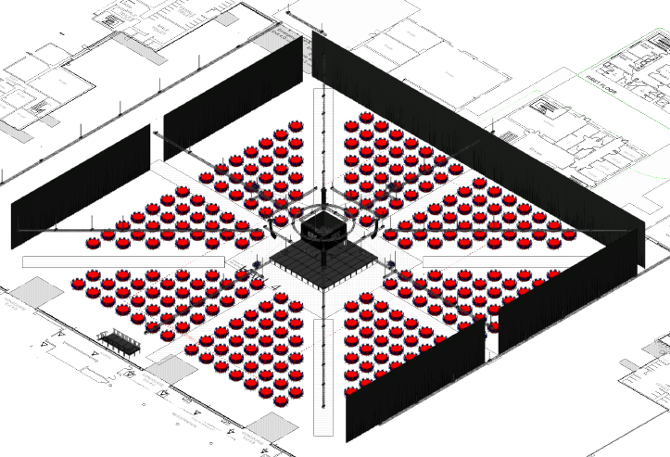
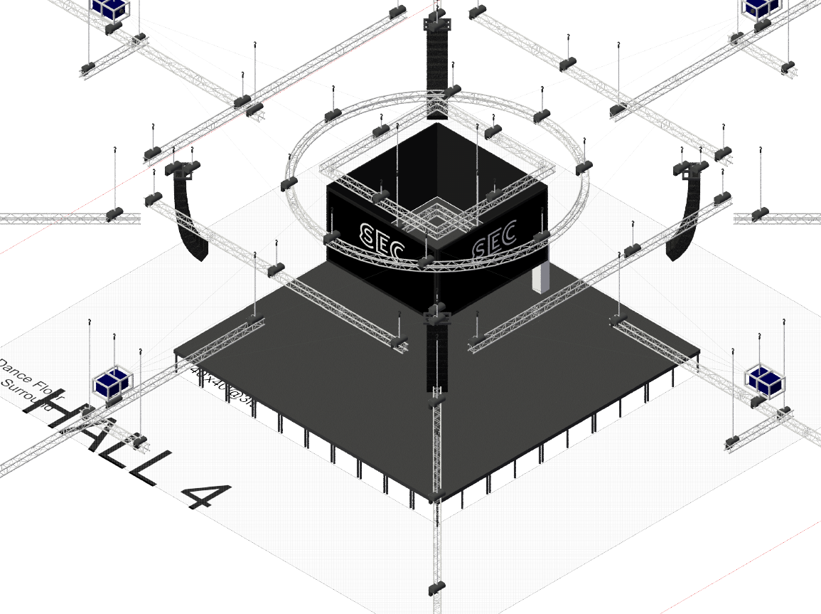
The Experience
An unforgettable evening of Scottish tradition and contemporary pride:
Pipes, drums, and the Immortal Memory to Burns
A curated three-dram whisky tasting led by masters of the craft
A traditional three-course Burns Supper
Laughter, dance, and ceilidh under one roof
A feast for the senses. A moment for the ages.
Culminating in 2 World Records.

Slide 6
The Atmosphere
The sound of pipes rising through candlelight.
The shimmer of tartan and gold.
The warmth of 2,500 voices joining in Auld Lang Syne.
A living celebration of Scotland — crafted with heart, shared with pride.

Slide 7
The Cause
Every penny gained, after operational costs goes to supporting the
My Name’5 Doddie Foundation,
raising funds for research and care for those living with Motor Neurone Disease.
Whilst whisky warms the heart — giving back gives it purpose.

Slide 8




The Team Behind the Dream
A Dram of Destiny is built by believers — whisky lovers, producers, storytellers, and proud Scots united by a single goal: to create a night worthy of Scotland’s heritage and Doddie’s legacy.
Led by Barrel & Brand, and so far, supported by partners including Glencairn, Larkfire, Slanj, we’re assembling a team where:
Every skill shared makes the event stronger,
Every hand helping keeps the costs lower,
And every saving means more funds for the My Name’5 Doddie Foundation.
This is a collective effort — a community coming together to make history.
The more who stand with us, the greater the legacy we leave behind.
Your
LOGO Here?
Your
LOGO Here?
Your
LOGO Here?

Slide 9
Join the Movement
This is a call to:
- Whisky brands — to pour their spirit into something unforgettable
- Sponsors — to stand beside a record-breaking cause
- Guests — to take their seat in history
For everyone - be part of the story.
#IWASPARTOFIT

Slide 10
The Toast
Here’s to Scotland —
its people, its poetry, its craftsmanship, and its courage.
On 30 January 2027, history will be made in Glasgow.
Raise your glass and be part of the legacy.
‘A Dram of Destiny’
www.dramofdestiny.com

